Slide 1
Land acknowledgment
Library Staff Day – August 24, 2021
Dr. Maggie Holland she/her (GES)
Dr. Shelly Wiechelt she/her (BSWP)

Slide 2
Today’s session
Introduction – positionality
Indigeneity & Indigenous relationships with land
Recognition of Indigenous rights / lands
Land acknowledgment – general history
Land acknowledgment concerns & guidance
Land acknowledgment working group (OEI/UMBC)
Action moving forward…
US universities & land acknowledgments

Slide 3
UMBC’s land acknowledgment
UMBC was established upon the land of the Piscataway Conoy and Susquehannock peoples. Over time, citizens of many more indigenous nations have come to reside in this region. We humbly offer our respects to all past, present, and future indigenous people connected to this place.
(crafted by Dr. Ashley Minner, Professor of the Practice and Folklorist in the Department of American Studies, member of Lumbee Tribe of North Carolina, https://amst.umbc.edu/faculty-and-staff/ashley-minner/)

Slide 4
What does it mean to be indigenous?
Self-identification as ‘indigenous’
Distinct language and culture
Distinct beliefs or cosmologies
Distinct and customary social, economic, and political conditions or systems
Strong link between livelihoods and territory, ecosystem goods, and services
Occupation of ancestral lands, or portions of them
Historic continuity with pre-colonial/pre-settler societies
Indigeneity = Indigenous + Identity
A population’s distinct set of knowledge, beliefs, interpretations, and practices about the natural world, referred to as ‘cosmologies’
International Labour Organisation, 1989, Convention 169 on Indigenous and Tribal Peoples in Independent Countries,
available at http://www.ilo.org/dyn/normlex/en/f?p=NORMLEXPUB:12100:0::NO::P12100_ILO_CODE:C169
http://www.un.org/esa/socdev/unpfii/documents/5session_factsheet1.pdf

Slide 5
Indigenous relationships to land
Avoid generalizations
Notions of land as property ; natural resources ; existence of boundaries/borders; humans as separate from natural world ; subjects vs. object → settler colonialism
Robin Wall Kimmerer (Anishinaabe) – replace “it” – adopt “ki” or “kin” (returns animacy to nature)
Ecuador’s 2008 Constitution: recognition of IP rights and rights of nature (Pachamama)
Decolonization means return of land to tribes – land back

Slide 6
Recognition of indigenous lands
More than one-half of land on Earth is held collectively – by communities & Indigenous Peoples
Only 1/5 of those lands are legally recognized by the state
Majority of forested land in the Tropics = traditional territories of Indigenous Peoples
“Formal” recognition as a fundamental right
LandMark Map - http://www.landmarkmap.org

Slide 7
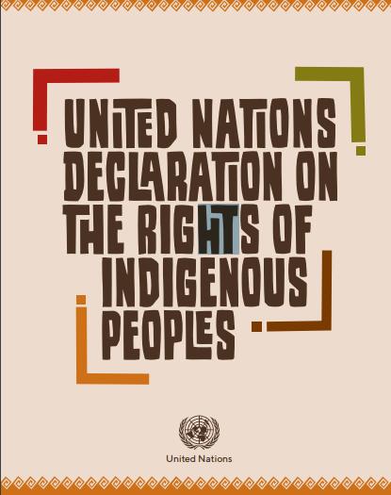
UN Declaration on the rights of indigenous peoples (UNDRIP)
Adopted in 2007 – 144 nations as signatories (4 voted against ; 11 abstained)
UN working group first established in 1982 (Martinez Cobo study)
Free, prior, and informed consent (FPIC) – as process
https://www.un.org/development/desa/indigenouspeoples/declaration-on-the-rights-of-indigenous-peoples.html

Slide 8
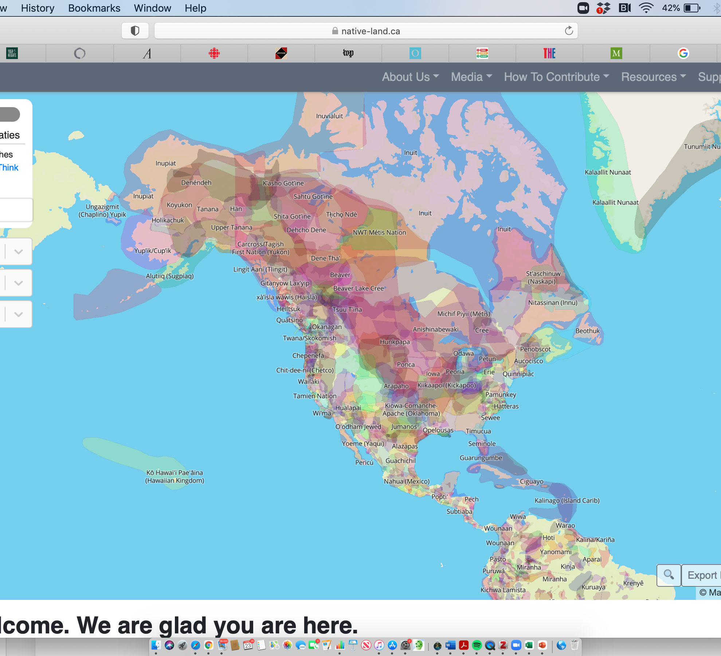
Indigenous people in the USA
574 tribes as federally-recognized (BIA)
> 200 tribes lack federal recognition (not registered, ineligible for federal funding)
Maryland has 3 federally-recognized tribes: the Piscataway Indian Nation, the Piscataway Conoy Tribe, and the Accohannock Indian Tribe
Native-land.ca

Slide 9
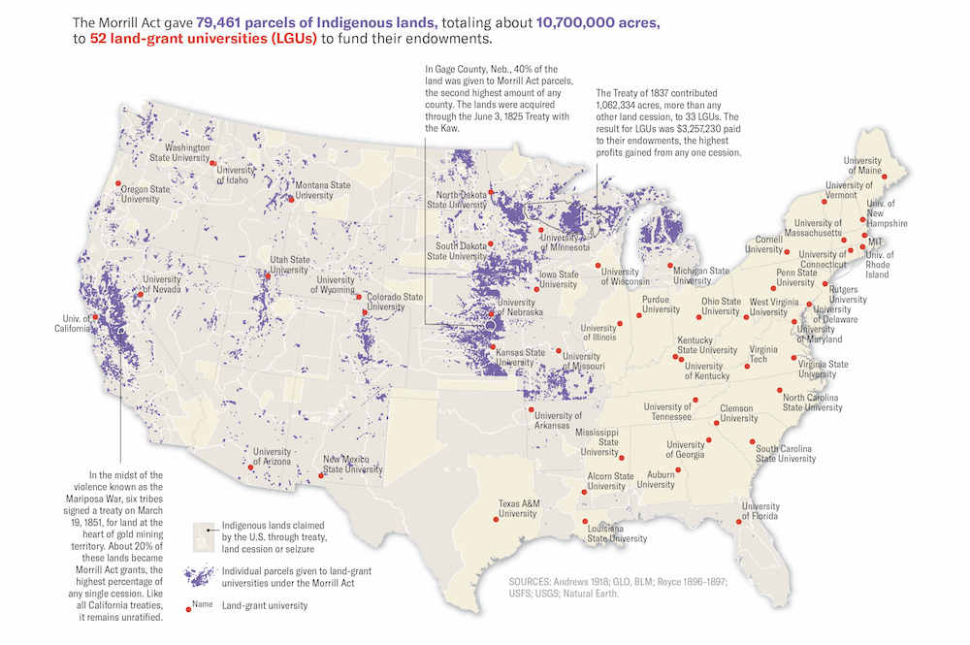
US land grant universities as “land grabbing” institutions
Indian Removal Act (1830) – Pres. Jackson, Trail of Tears
Morrill Act (1862) – Land Grant colleges (1890 included Confederate states)
Interactive web map by HCN: www.landgrabu.org
Map design: Margaret Pearce, HCN, 2020

Slide 10
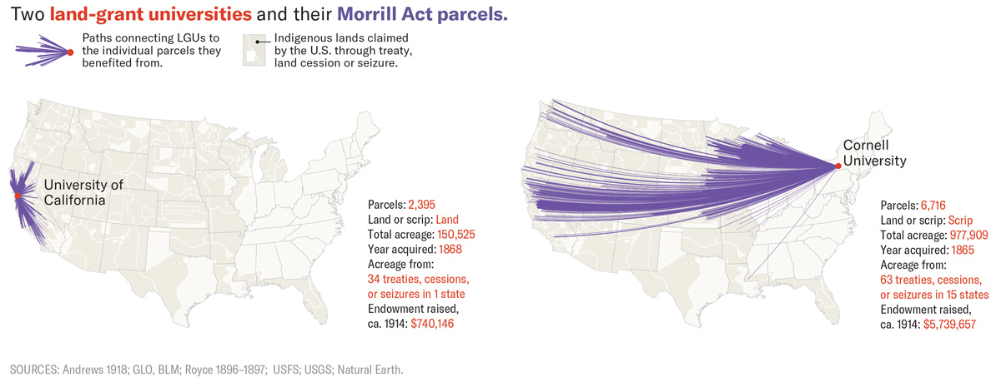
Full set of stories available here: https://www.hcn.org/topics/land-grab-universities
Map design: Margaret Pearce, HCN, 2020

Slide 11
US attempts an apology
2009-2010:
S.J. Res. 14 : A joint resolution to acknowledge a long history of official depredations and ill-conceived policies by the Federal Government regarding Indian tribes and offer an apology to all Native Peoples on behalf of the United States.
Interview with Layli Long Soldier, Lakota, Poet: https://onbeing.org/programs/layli-long-soldier-the-freedom-of-real-apologies-oct2018/
And her poem “38”: https://onbeing.org/poetry/38/

Slide 12
What is a land acknowledgment?
Excerpt from essay by Summer Wilkie (Cherokee, U. Arkansas, April 2021)
There is no one script.
Some guidance: (Source: https://nativegov.org/a-guide-to-indigenous-land-acknowledgment/)
Start with self reflection
Research your local context (past & present)
Use appropriate language ( recognize violence – don’t “sugarcoat”)
Use past, present, and future tenses in statement
Consider using celebratory language vs. grim

Slide 13
What is a land acknowledgment?
Offer clear guidance on when/where should be used
Don’t ask Indigenous person to deliver welcome statement
Build authentic relationships between institution and Indigenous people / tribes
Don’t take advantage of emotional/social/physical labor in this work
In crafting land acknowledgment, recognize role that displacement might have played
Source: https://nativegov.org/a-guide-to-indigenous-land-acknowledgment/)

Slide 14
A (very brief) history of land acknowledgments
Australia, New Zealand, Canada, United States – recognize these 4?
Excerpt from piece in New Yorker: “Canada’s Impossible Acknowledgement” (2017)
Land acknowledgment can only be a beginning. It is a “step against indigenous erasure”*. It is a call to action.
* www.insightintodiversity.com/acknowledging-native-land-is-a-step-against-indigenous-erasure

Slide 15
Concerns expressed by indigenous
Statements lack authenticity (repetitive; lacking context; said without feeling; mispronunciations)
Statement is simply to “check a box” in overall DEIJ initiatives
Many statements speak to an Indigenous past, but not a present (erasure)
“Settler moves to innocence” *
Land acknowledgment ≠ decolonization
* Phrase from Tuck & Yang (2012)’s “Decolonization is not a metaphor”
Source for concerns: “Indigenous Artists Tell Us What They Think About Land Acknowledgements” – G. Isador at Vice.com, August 9, 2019

Slide 16
UMBC’s land acknowledgment
UMBC was established upon the land of the Piscataway Conoy and Susquehannock peoples. Over time, citizens of many more indigenous nations have come to reside in this region. We humbly offer our respects to all past, present, and future indigenous people connected to this place.
(crafted by Dr. Ashley Minner, Professor of the Practice and Folklorist in the Department of American Studies, member of Lumbee Tribe of North Carolina, https://amst.umbc.edu/faculty-and-staff/ashley-minner/)
Note: You can learn more about the land where you live by entering your address / hometown into http://nativelands.ca
Nacotchtank & Piscataway = Takoma Park, MD

Slide 17
Land acknowledgment working group
Convened in beginning of 2021 as working group for Inclusion Council
Initially combined with Divestment working group (now separate)
5 active members (faculty, staff) – all non-Indigenous
Series of recommendations issued in report to OEI in May 2021
Immediate actions: Outreach with Piscataway; connections with groups in Baltimore; connecting students/faculty/staff who identify as Indigenous; outreach/engagement re: UMBC’s statement and suggested use

Slide 18
UMBC Library action on land acknowledgment
Special collections – history and present of Indigenous Peoples in Maryland & beyond.
Invited speakers
Storytelling – oral histories
Gallery space – exhibits
Assistance with “decolonizing” the syllabus, reading list, citations – access to references
What more? Your ideas!

Slide 19
Thank you
Maggie Holland – GES – mholland@umbc.edu
Shelly Wiechelt – BSWP – wiechelt@umbc.edu

